Slide 1
R. Gopakumar
Multidisciplinary Visual Artist
“I believe the work of art should change the existing visual, intellectual and aesthetic sense and experiment with finding new visual phenomena. “
#techspressionist #visualartist #digitalartist #collector

Slide 2
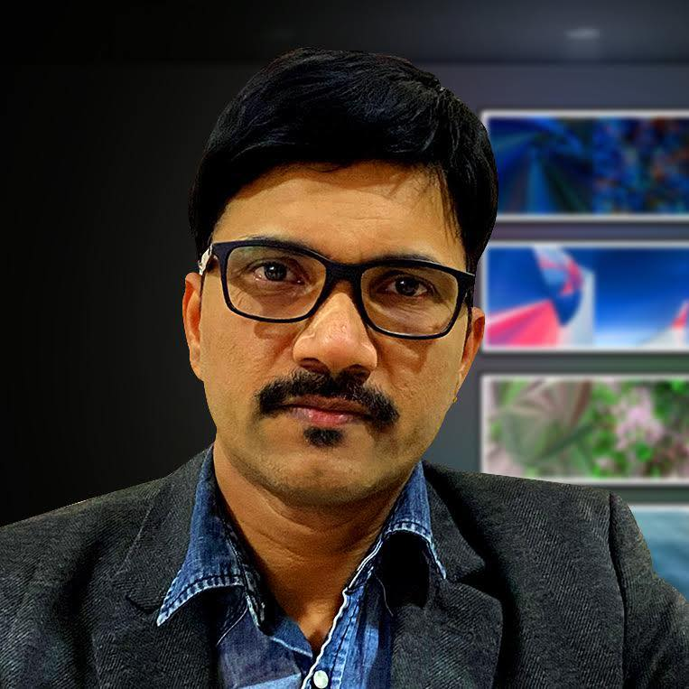
About Me
I am an Indian multidisciplinary artist. I worked in different media including Digital Art, Motion Photography, Installation, Drawing, Painting and Print.
I used art & technology to discuss and expose the environmental, political, and social issues of the society.
Education and Training:
1990-1995 Five Year NDFA (Painting) from The Raja Ravi Varma College of Fine Arts, Kerala, India.
2007 History of Art Diploma Course – London Art College, UK.
2012 – Contemporary Art Course – Museum of Modern Art (MoMA), USA
2014 – Catalysts Course: Artists Creating with Sound, Video, and Time training from Museum of Modern Art (MoMA), New York, USA.
2015 ART of the MOOC: Merging Public Art and Experimental Education, Duke University.
Awards and Achievements
My Motion Photography Art were shortlisted by the Saatchi Gallery London for their inaugural Motion Photography Prize.
Scholarship Kerala Lalitha Kala Academy
1st Place Winner , 2nd NeoPopRealism Starz Art Competition, USA.
“Honorable Member” Immagine Poesia, Trino, Italy
“Super Patron” The Virtual Online Museum of Art is the world’s first virtual museum (voma.space)
Bangalore University included my Digital art practice and biography in their Bachelor of Visual Arts (BVA) Syllabus.
Founder Techspressionism India (techspressionism.com/)
R.Gopakumar

Slide 3
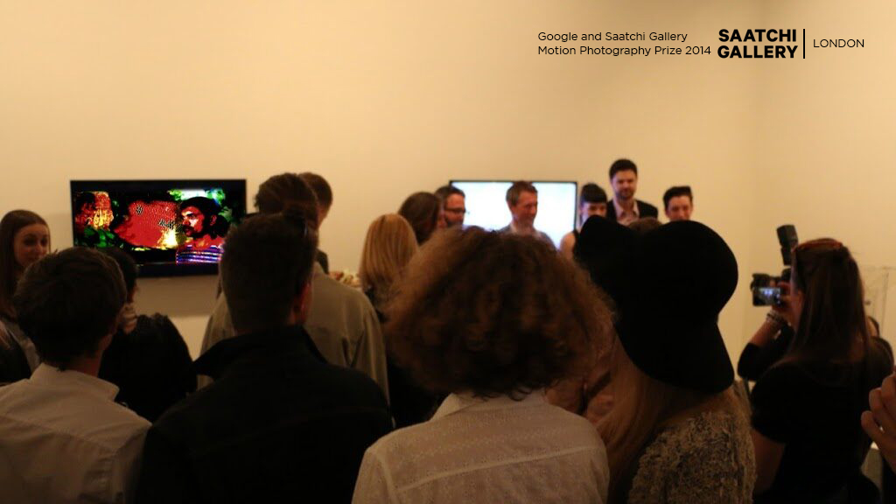
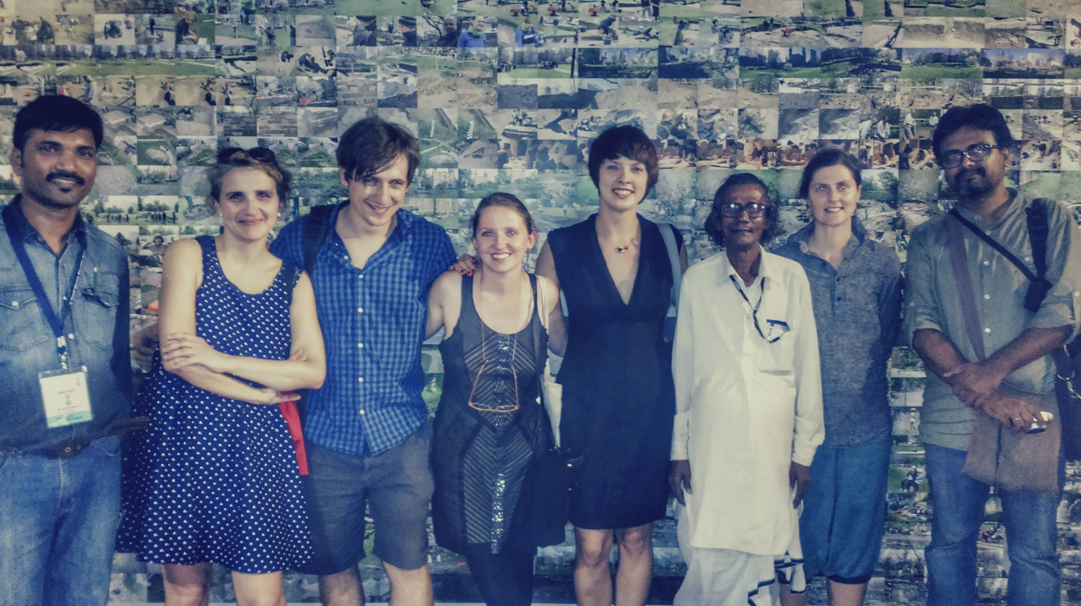
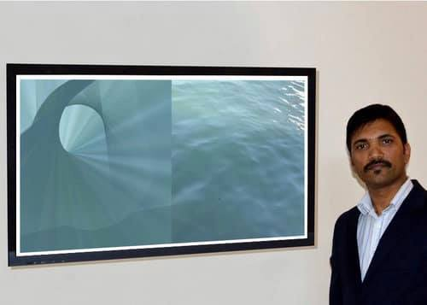
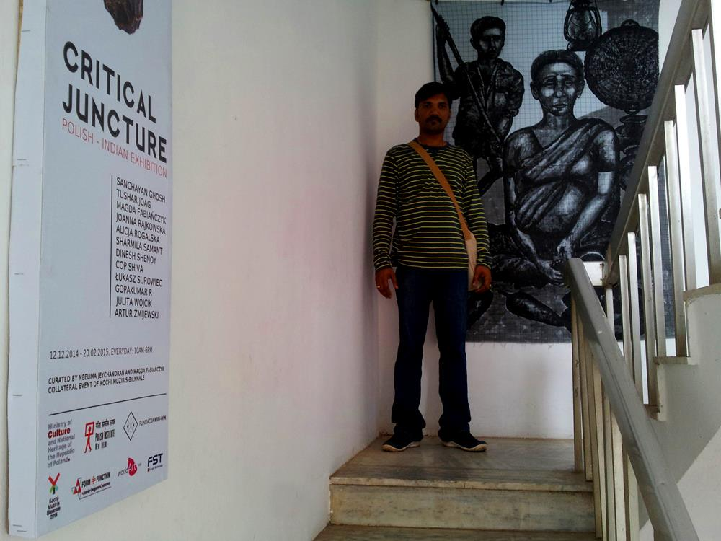
Exhibitions
Saatchi Gallery London, UK.
Tate Britain, UK.
CADAF Crypto and Digital Art Fair, France.
V-Art Digital Art Spaceship Exhibition – Ukraine
Museum of Modern Art, USA (Yoko Ono Wish Tree)
The Wrong Biennale , Alicante, Spain
Kochi-Muziris Biennale, Kochi, India (Collaterals)
CICA Museum, South Korea
The Kinsey Institute Art Gallery, USA.
Bahrain Museum, Manama, Bahrain
National Gallery of Modern Art, New Delhi, India
And many more…

Slide 4
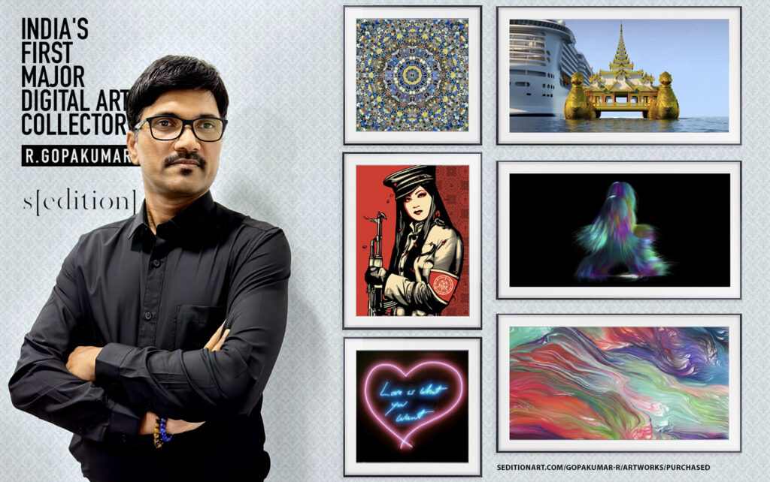
Digital Art Collector
Damien Hirst
Shepard Fairey
Tracey Emin
Jenny Holzer
AES+F
Mat Collishaw
Lawrence Weiner
Michael Craig-Martin
Isaac Julien
Tim Noble & Sue Webster
Jane & Louise Wilson
Mark Titchner
Refik Anadol
Bob & Roberta Smith
Ergin Çavuşoğlu
Universal Everything
Ryoichi Kurokawa
Angelo Plessas
Quayola
Casey Reas
Bharti Kher
Jitish Kallat
Sui Jianguo
Liu Ye
Wim Wenders
lmgreen & Dragset
Many More…
R.Gopakumar
130+ Artists | 250+ Artworks

Slide 5
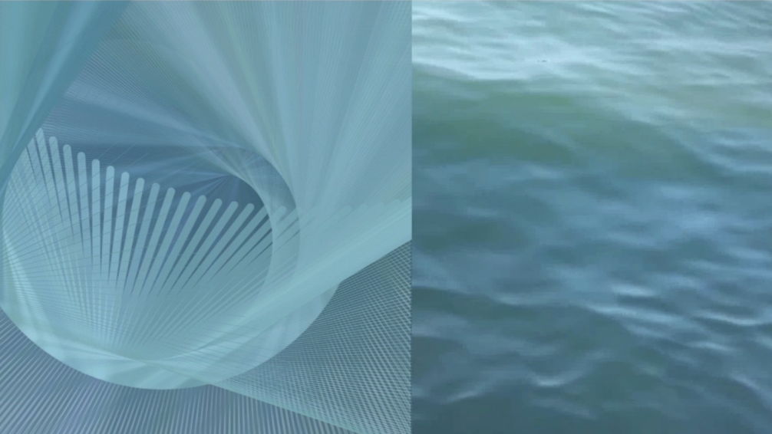
Traditional Art

Slide 6
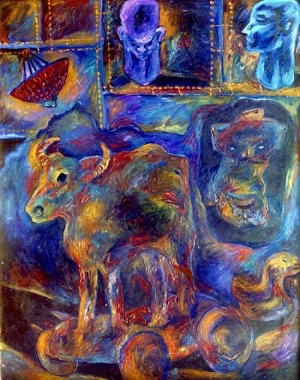
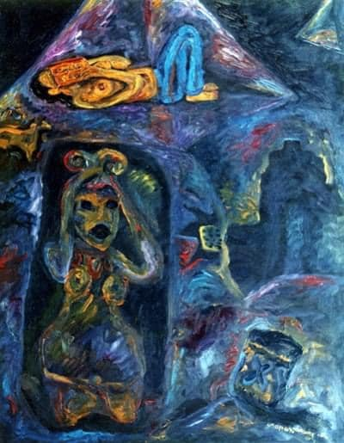
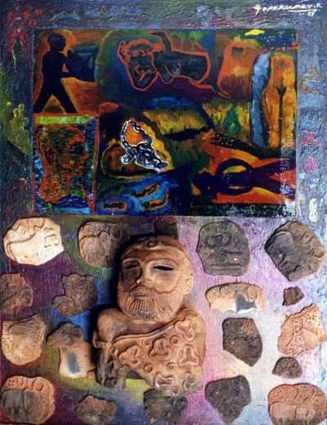
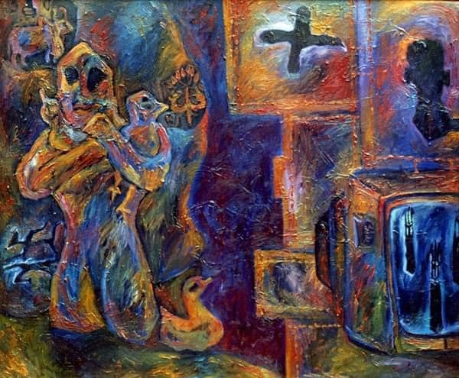
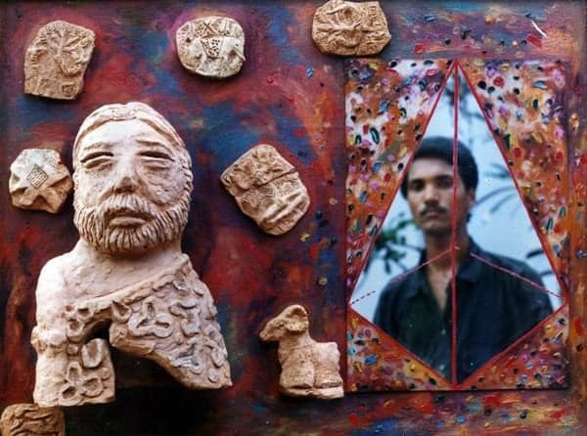
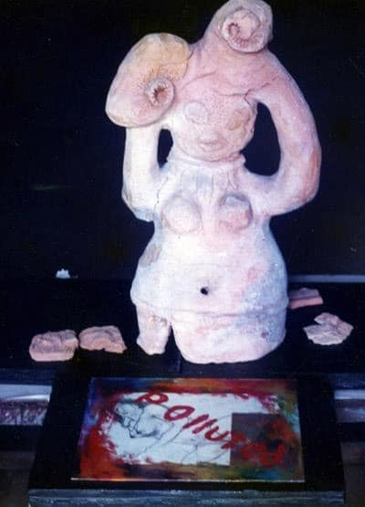
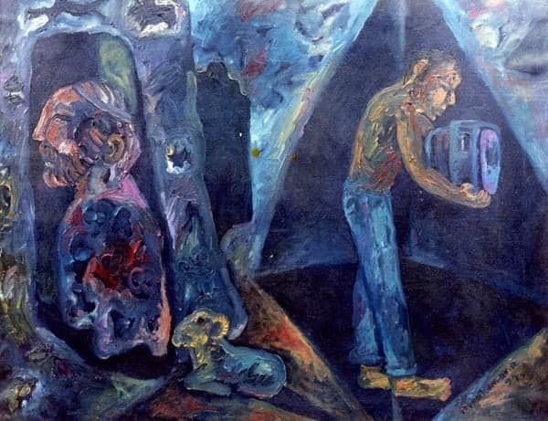
The Contrast Series
R.Gopakumar
Medium: Mixed Media, Year: 1995

Slide 7
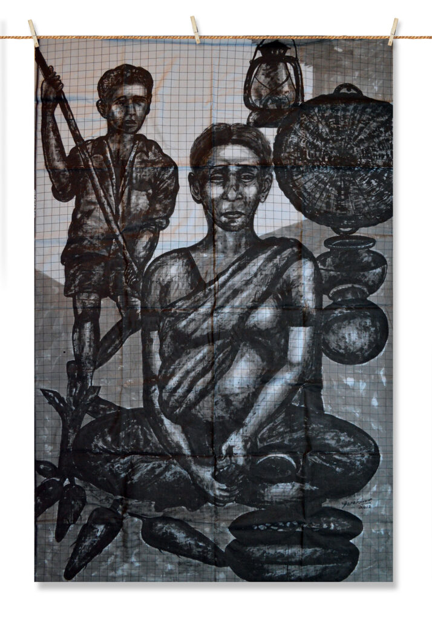
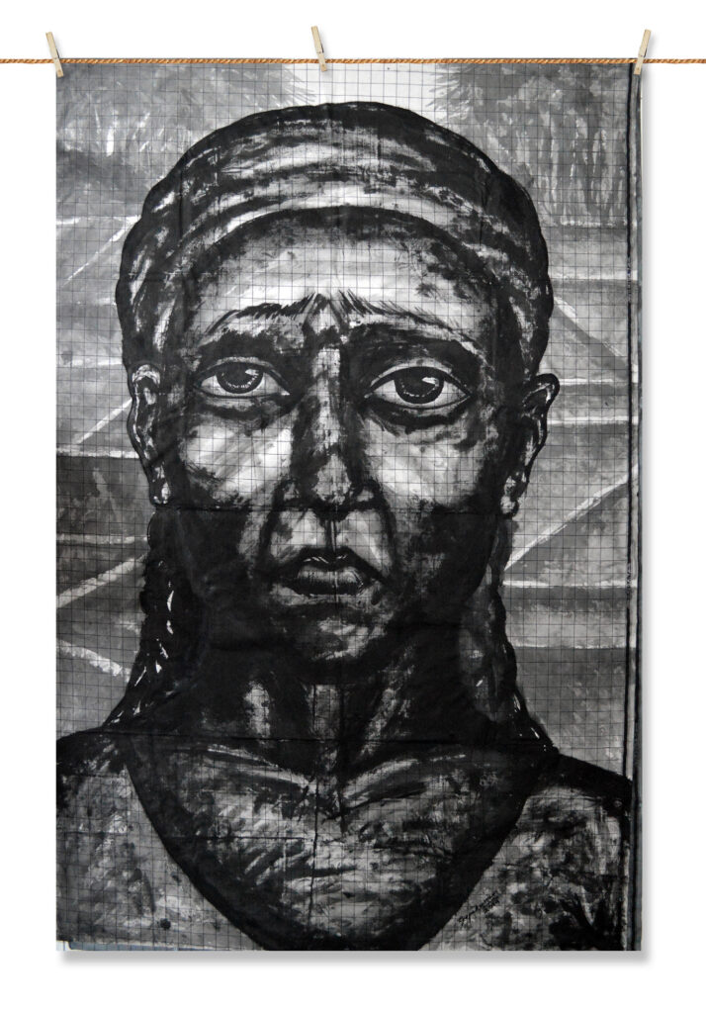
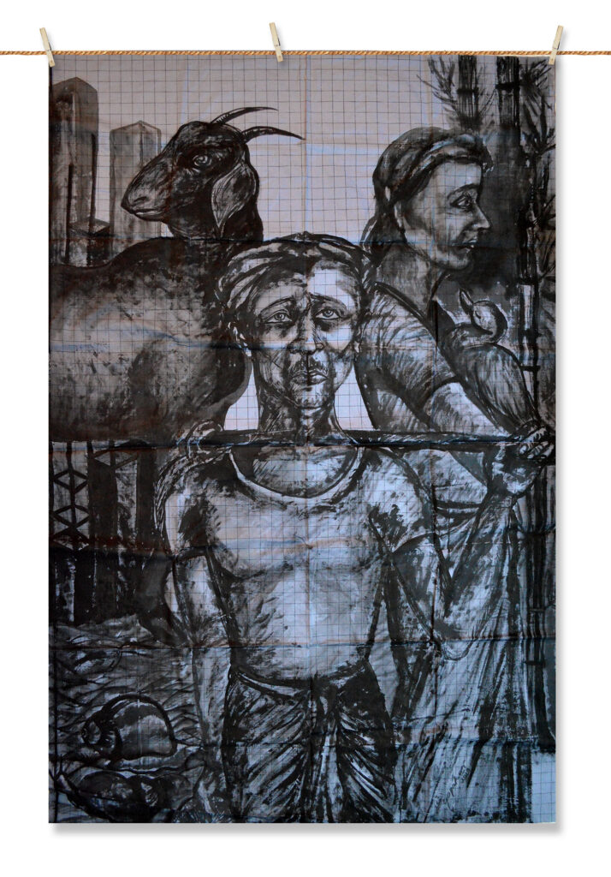
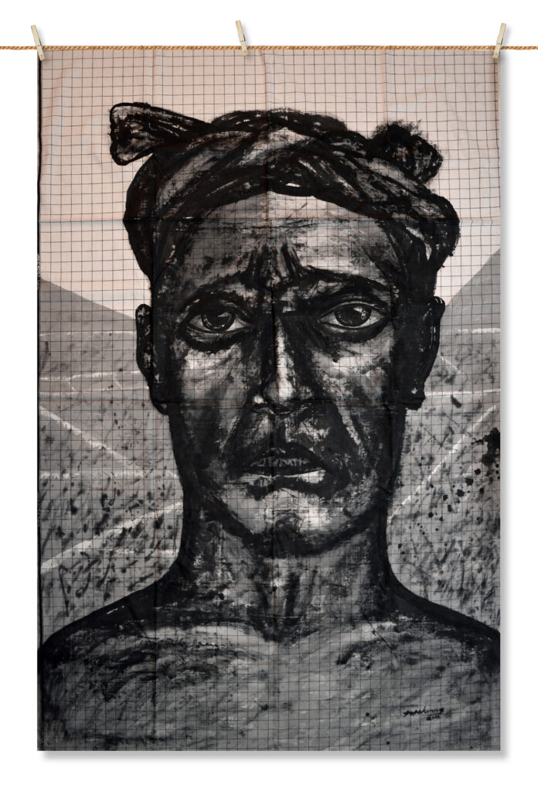
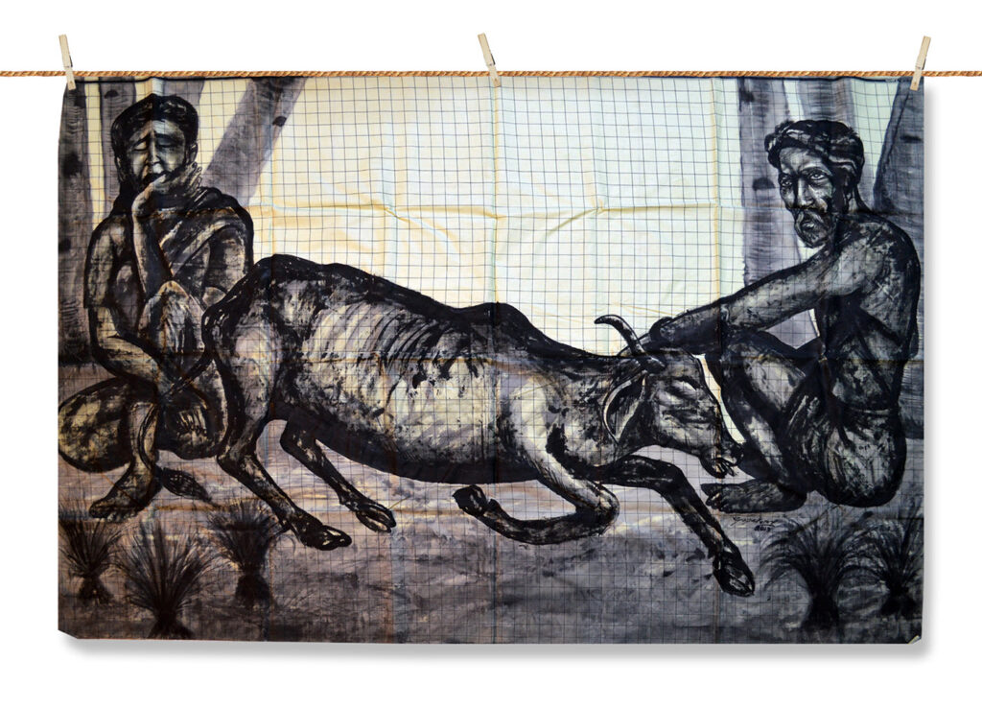
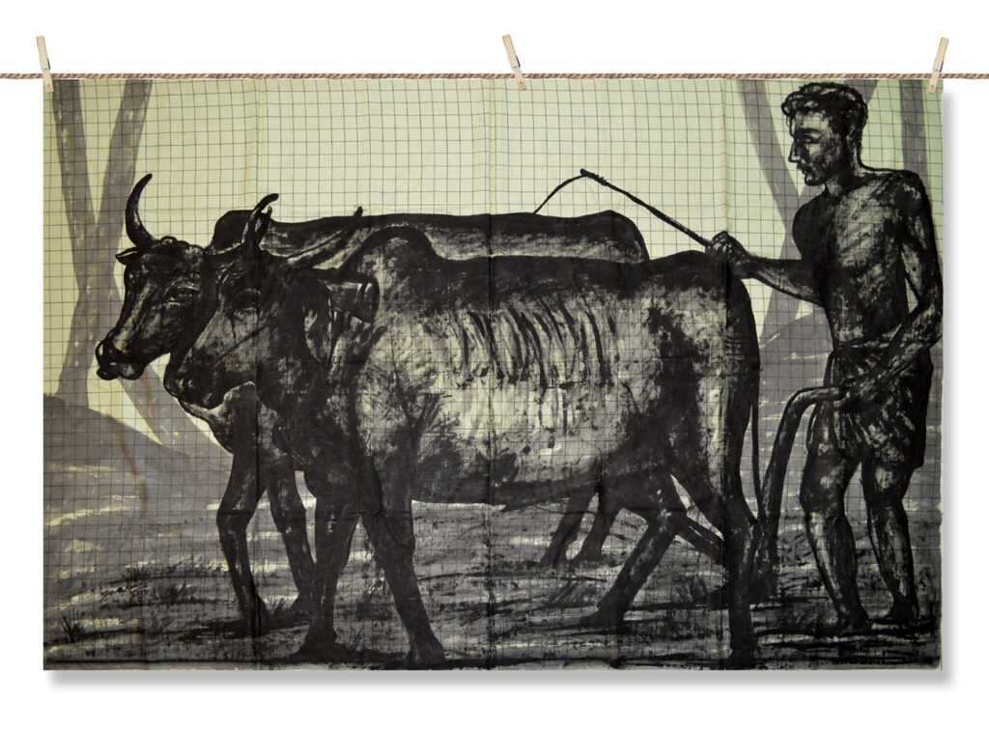
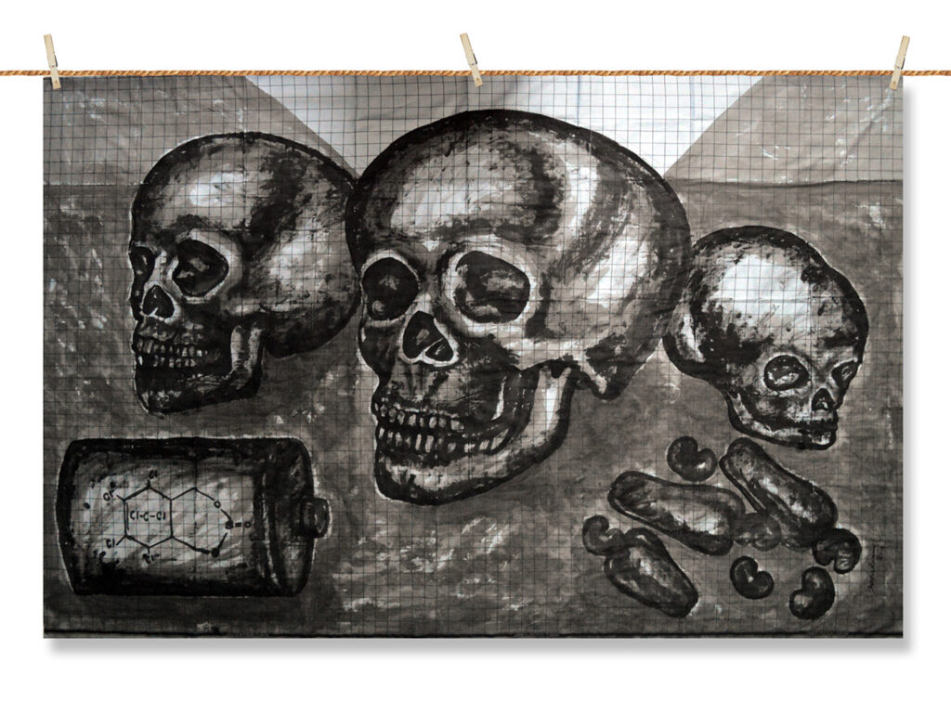
The Lungi Series
(Collateral Projects)
Exhibition Details
R.Gopakumar
Medium: Indian Ink on Indian Lungi (Cloth), Year: 2013, Video Link

Slide 8
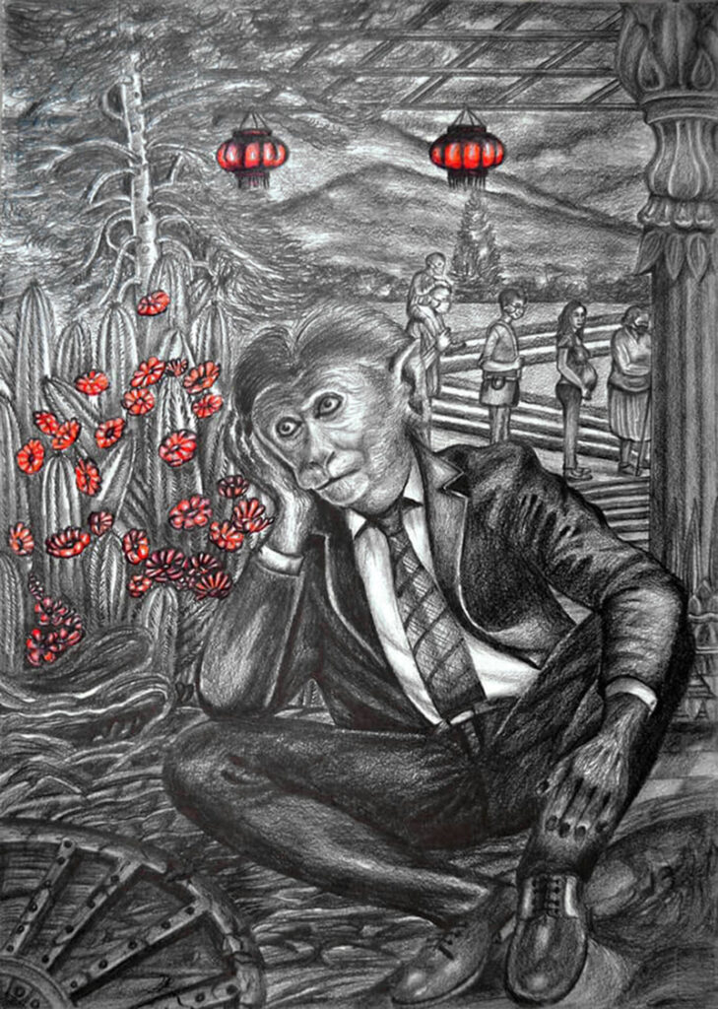
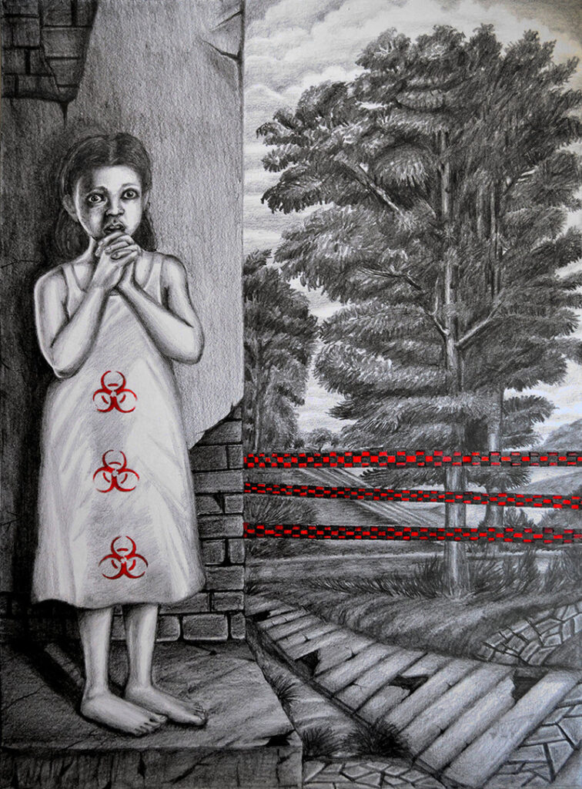
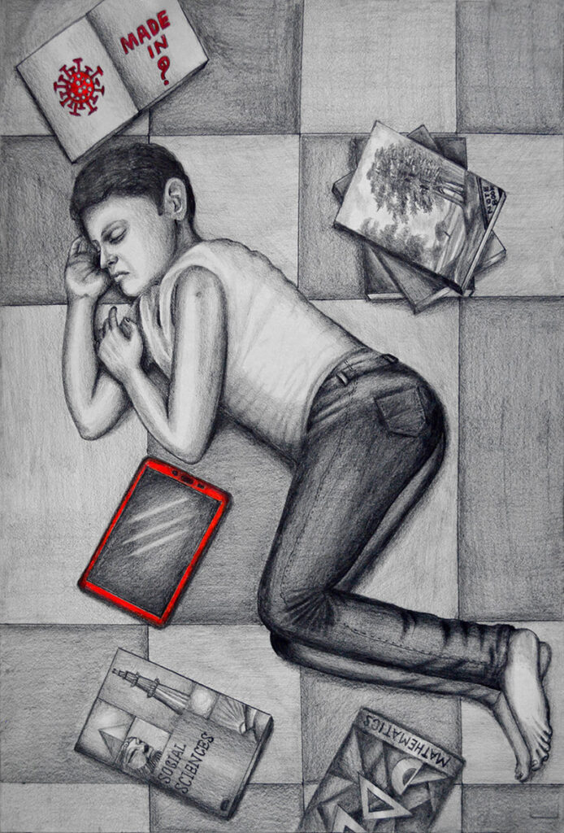
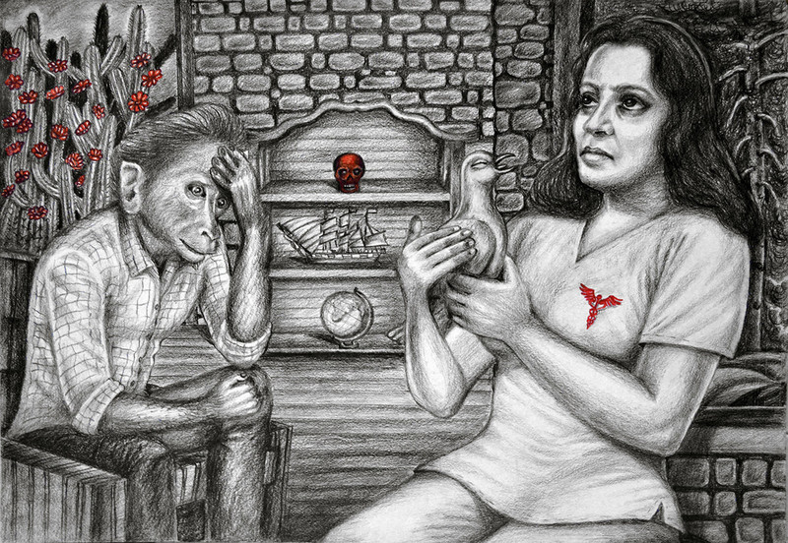
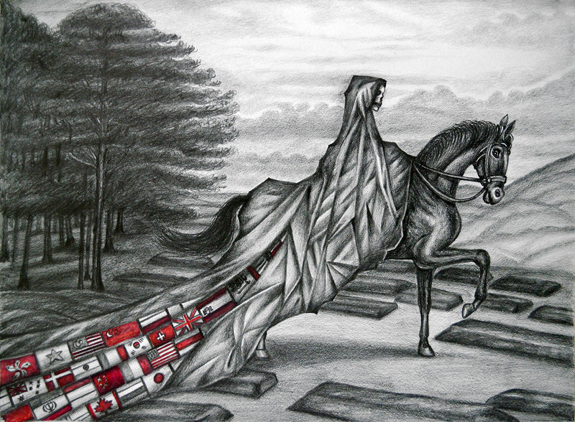
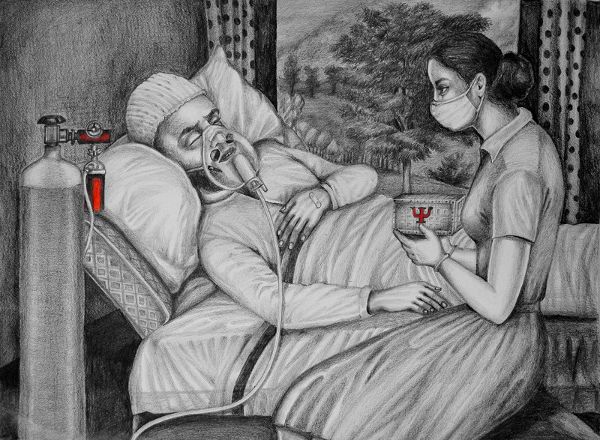
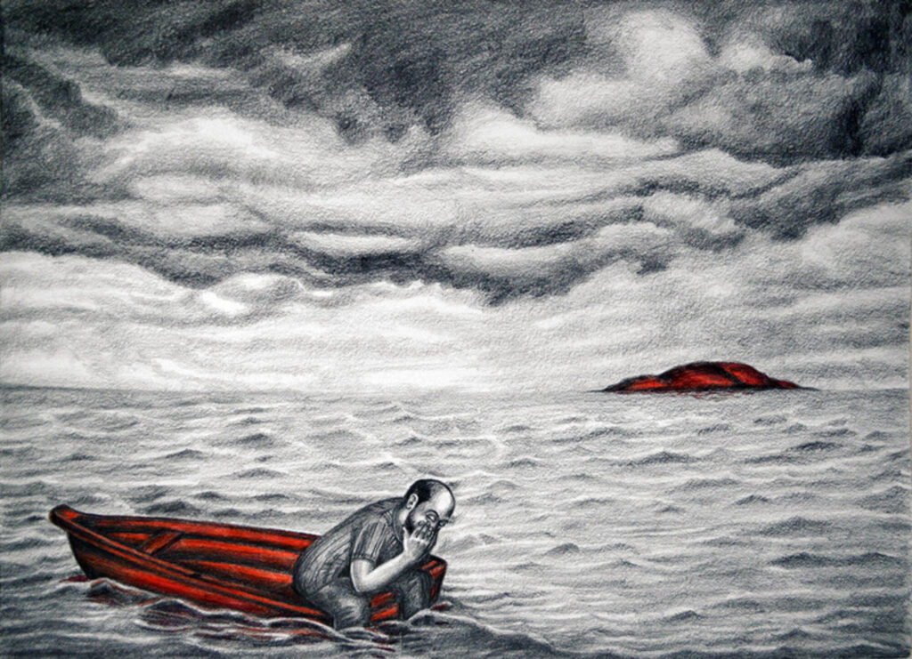
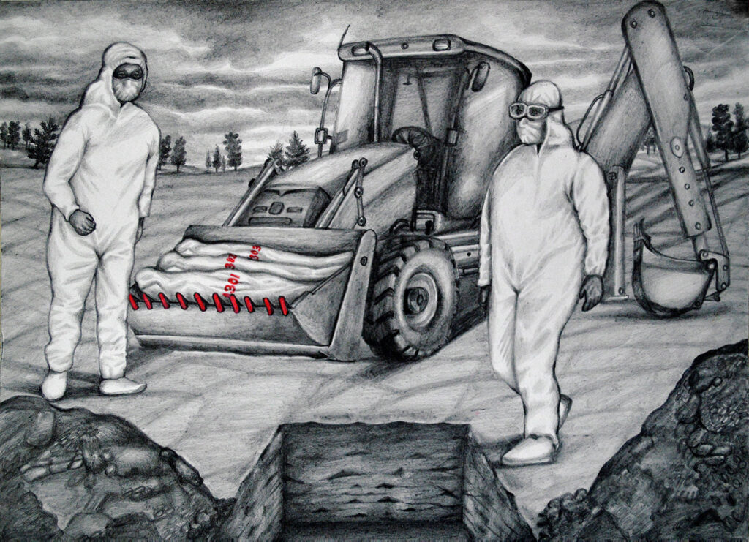
The Solitude Series
The Solitude series has been created based on the Pandemic situation, which affected almost all people of the world somehow or other. The agony, anxiety and turmoil of the humans shattered my mind so much that this work is being written from it. This series of work of art is inspired by the Theory of New Romanticism in Art.
Long Way
Red Zone
Distance
R.Gopakumar
Hope
Pandemic
Breath
Alone
Bury
More Information

Slide 9
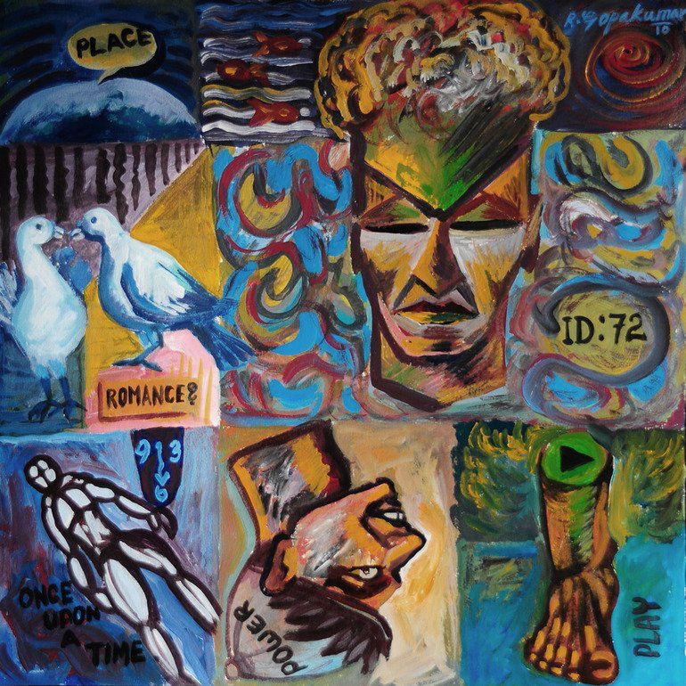
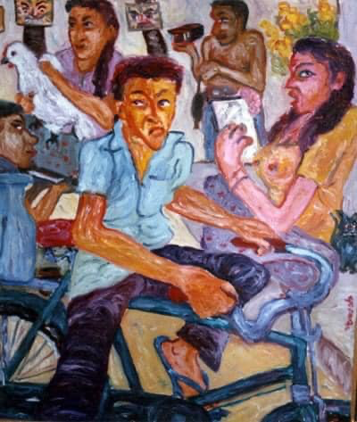
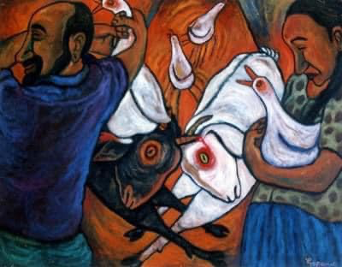
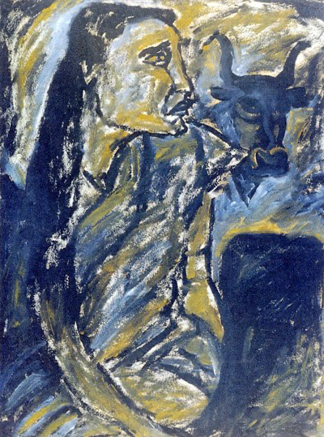
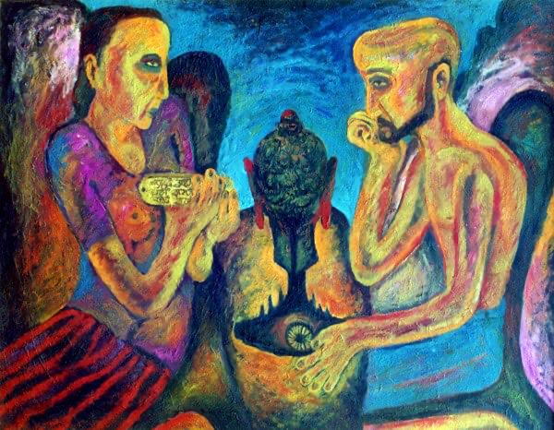
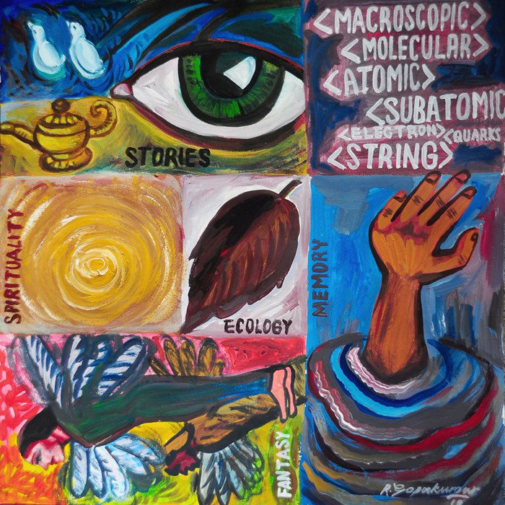
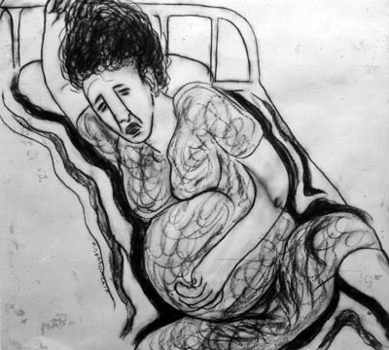
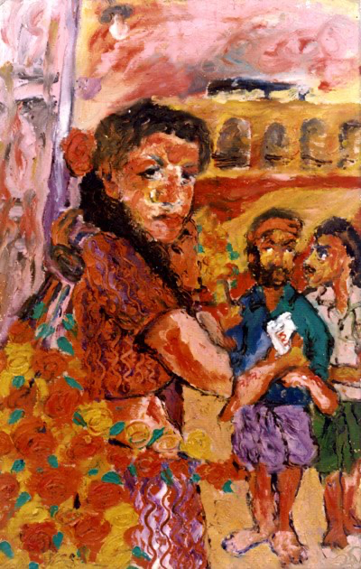
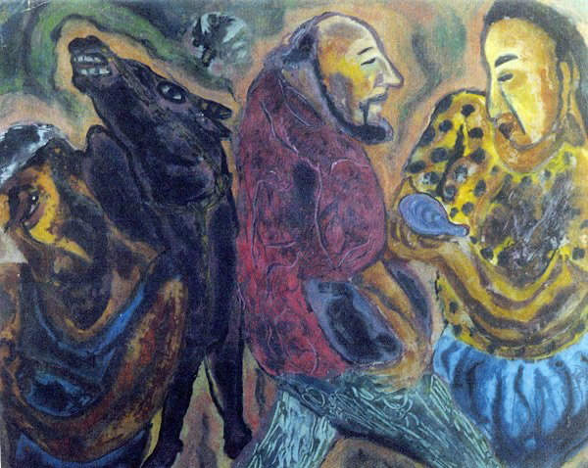
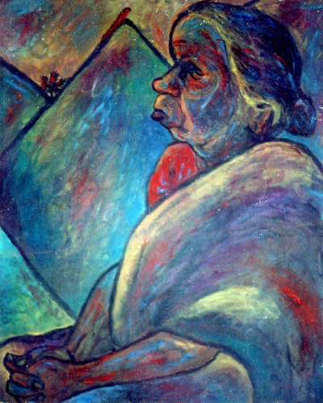
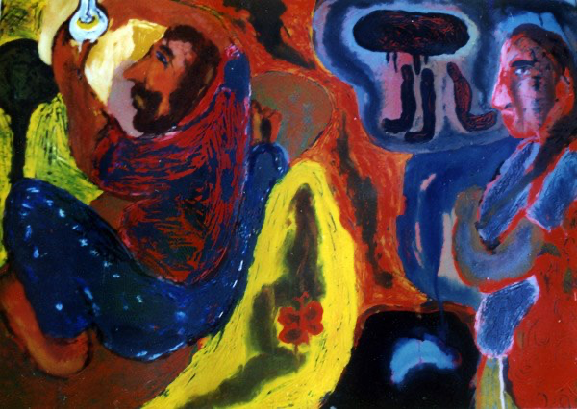
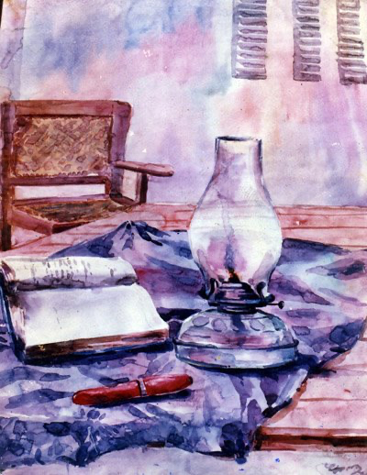
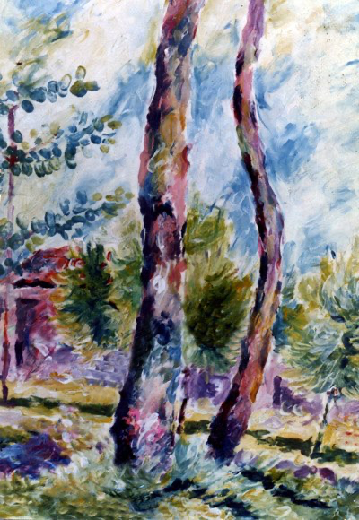
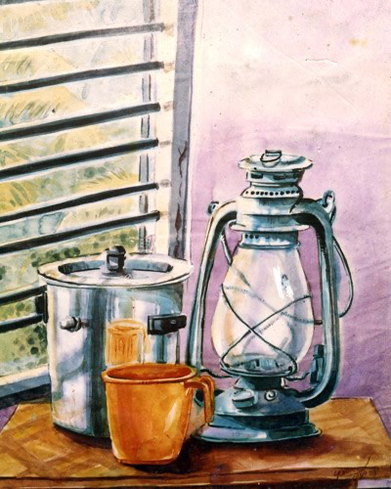
Old Paintings and Drawings
R.Gopakumar

Slide 10
Motion Photography

Slide 11
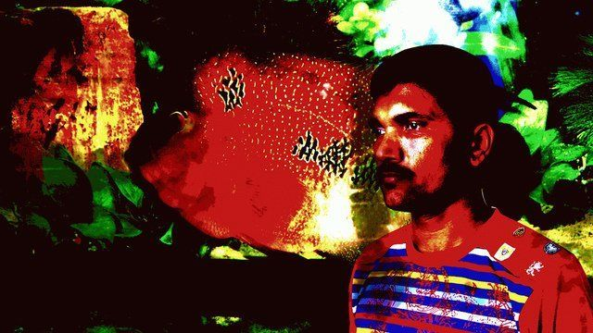
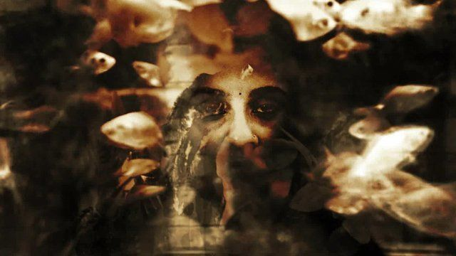
Motion Photography
On your own
Must not be beautiful
R.Gopakumar
The Mindscape
Exhibition Details

Slide 12
Digital Art 2008 to present

Slide 13
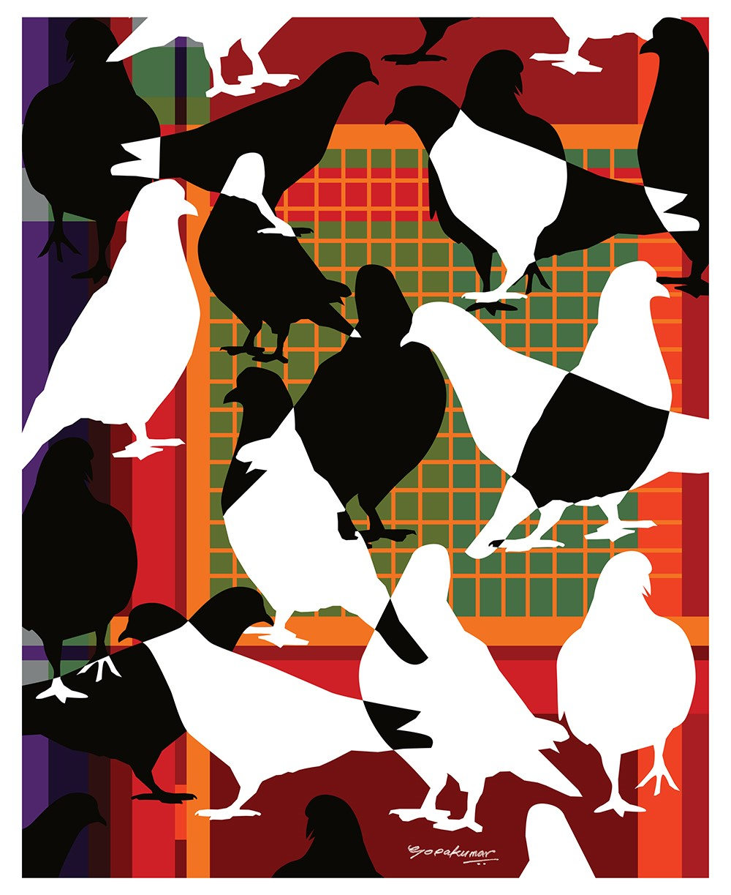
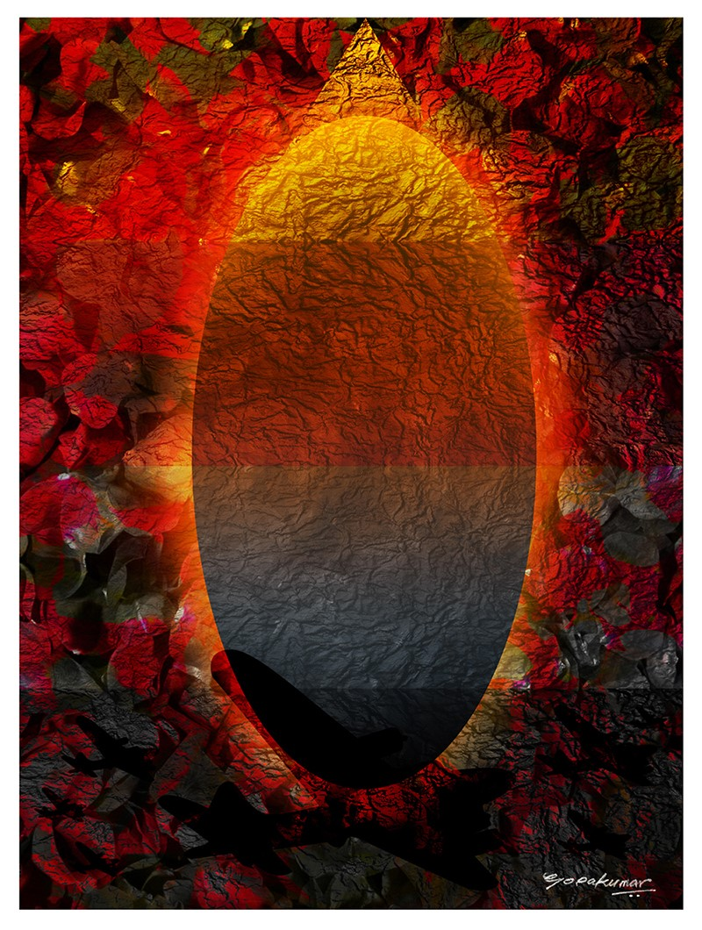
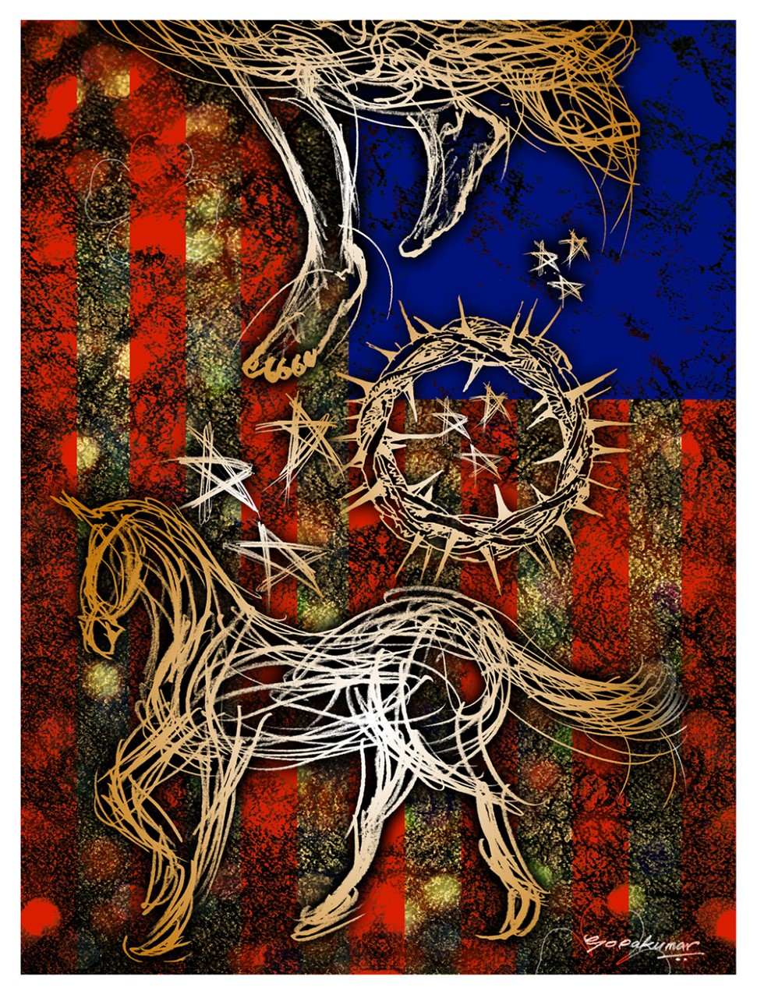
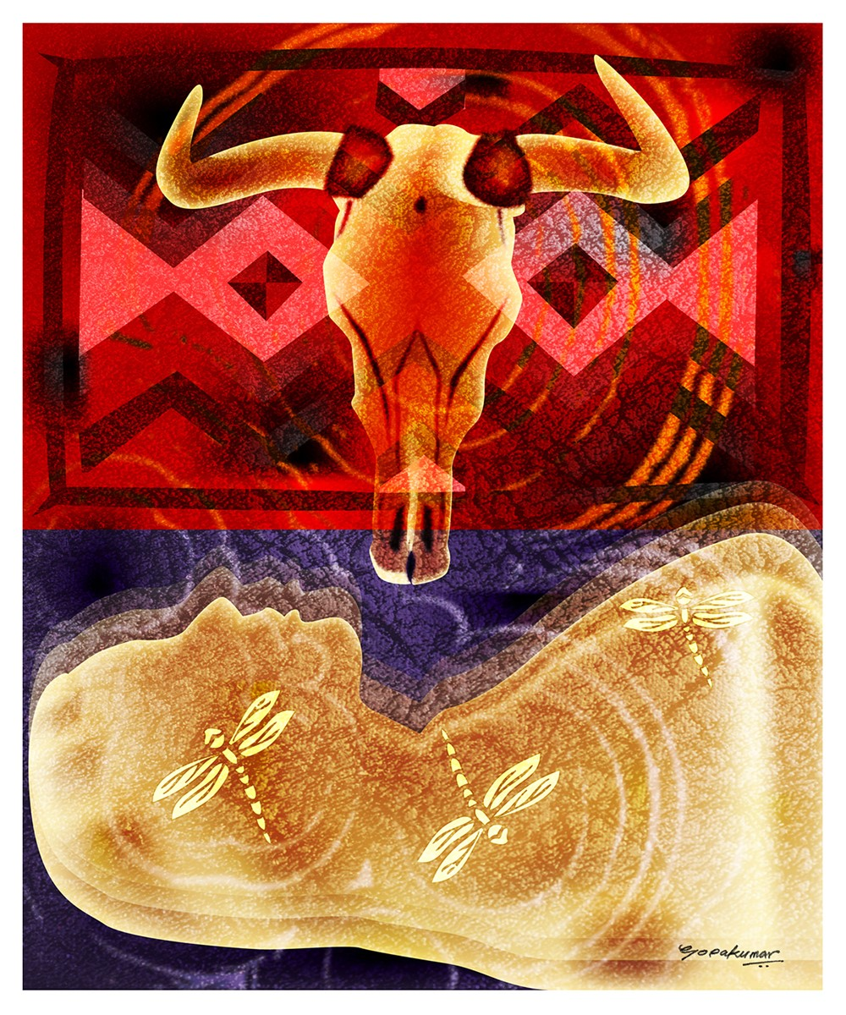
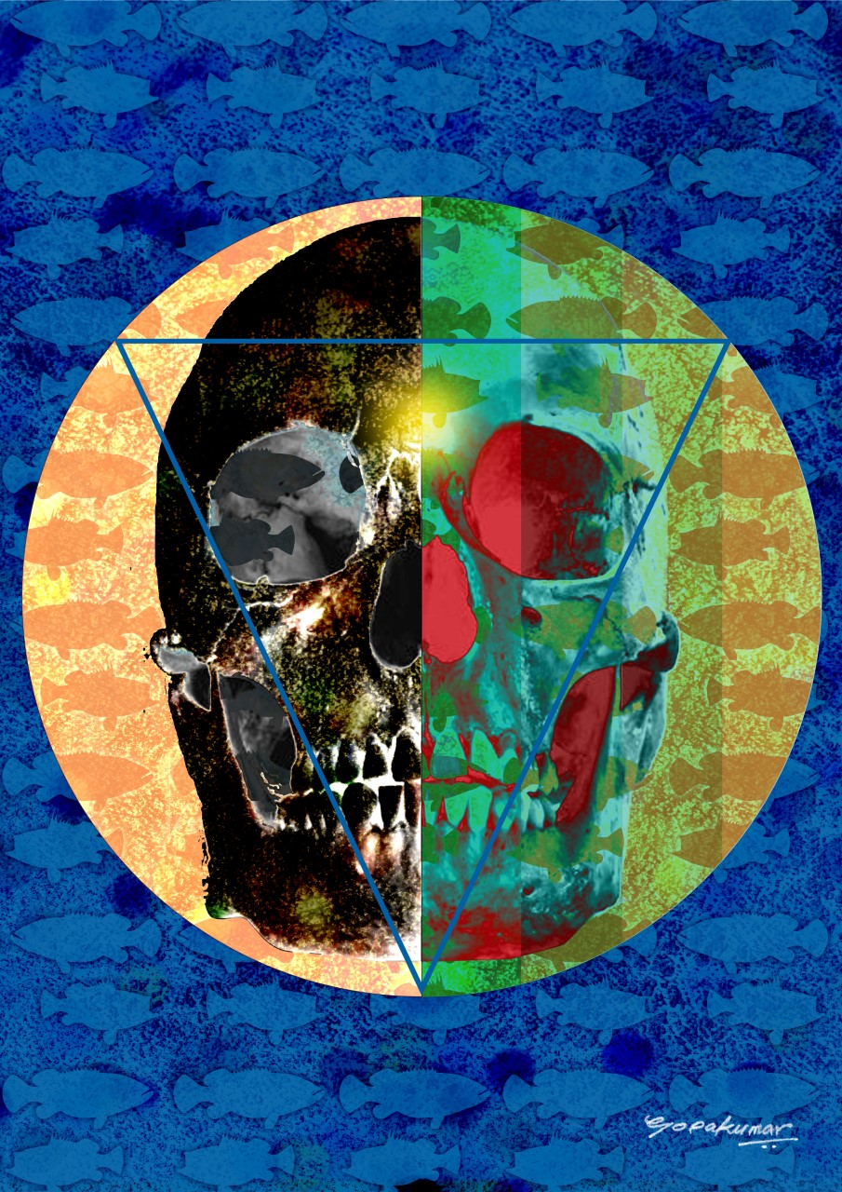
Immagine Poesia, Trino, Italy (Honorable Member)
IMMAGINE&POESIA is the international artistic literary movement founded in Torino, Italy, in 2007, under the Patronage of the late Aeronwy Thomas, daughter of Dylan Thomas.
The Charter Members were Aeronwy Thomas (poet and writer), Gianpiero Actis (painter), Silvana Gatti (painter), Sandrina Piras (poet) and Lidia Chiarelli (coordinator and ideologist of the Movement).
A literary text may inspire the creation of an artwork and vice versa: the result is a new and complete form of art.
Website
R.Gopakumar

Slide 14
Techspressionism India (Founder)
Techspressionism is introduced as a new art-historical term to describe fine artists using digital technology to convey subjective, emotional content.
Techspressionism distinguishes expressive fine art from such genres as “digital art,” which can include animated movies, and video games, as well as from “new media” works that do not embody convincing artistic intent.
An artistic approach in which technology is utilized as a means to express emotional experience. (Wikipedia)
A 21st century artistic and social movement (WIRED)
Group Founder:
Colin Goldberg (Artist/Curator), NY, USA.
Group Adviser:
Helen Harrison, Director of the Pollock-Krasner House and Study Center, NY, USA.
The Techspressionist Visual Artist Index includes artists working with technology from over 40 countries.
en.m.wikipedia.org/wiki/Techspressionism
techspressionism.com/
techspressionism.com/salon/
instagram.com/techspressionism.in
Tag: #techspressionism.in
Web: techspressionism.in
Founders India: R. Gopakumar
Malavika M Andrew
Advisers India: Shajan C Kumar
Suresh Nair
…
R.Gopakumar

Slide 15
Digital Art Projects and Concepts
Unhealed Wounds
Linguistics River (Net Project) 2012
R.Gopakumar
Life - Real Time 2012
Idol 2012
Smudged Movement-Self Portrait

Slide 16
Digital Art Projects and Concepts
101 Great Indian Portraits (Parametric Line Series)
R.Gopakumar

Slide 17
Digital Art Projects and Concepts
101 Great Indian Portraits (Parametric Line Series)
R.Gopakumar
Work Details

Slide 18
Generative Art

Slide 19
Generative Art
Ephemeral Void Seasons Series
This project explore aesthetic of abstract nature and the same time caution for ephemeral natural changes.
What I am experimenting with here is extracting color codes from images and video footages and creating a generative art out of them. Art in my view is the expression of ideas. I used As3 script (ActionScript 3) to generate this Generative animation.
Spring
Summer
R.Gopakumar
Video Link
Video Link
All Works Details

Slide 20
Generative Art
Ephemeral Void Seasons Series
Autumn
Winter
R.Gopakumar
Video Link
Video Link
All Works Details

Slide 21
Generative Art
Ephemeral Void Seasons Series
Monsoon
R.Gopakumar
Video Link
All Works Details

Slide 22
Generative Art
Ephemeral Void Elements Series
This project explores the aesthetic expression of the five elements, which are associated with manifestation of the five prime elements of nature.
This abstract spinning animated particle Video will be generated through digital manipulation of data, using synergy of each element’s video, sound, machine and code.
What I am experimenting with here is extracting color codes from images and video footage and creating a generative art out of them. Art in my view is the expression of ideas. I used As3 script (ActionScript 3) to generate this Generative animation.
R.Gopakumar
Project Link
All Works Details

Slide 23
Generative Art
R.Gopakumar
Ephemeral Void Elements - Space
Artspaceship Project, V-Art

Slide 24
Generative Art
R.Gopakumar
Ephemeral Void Elements - Air
Video Link

Slide 25
Generative Art
R.Gopakumar
Ephemeral Void Elements - Earth
Video Link

Slide 26
Generative Art
R.Gopakumar
Ephemeral Void Elements - Water
Video Link

Slide 27
Generative Art
R.Gopakumar
Ephemeral Void Elements - Fire
Video Link

Slide 28
Artificial Intelligence (AI) Generated Art

Slide 29
(AI) Generated Art
Between Man and Nature
R.Gopakumar
This Artificial Intelligence (AI) generated Art created from the great Indian poet K Satchidanandan's poem "Birds come after me".
AI Project details

Slide 30
(AI) Generated Art
Between Man and Nature (Details)
R.Gopakumar
This Artificial Intelligence (AI) generated Art created from the great Indian poet K Satchidanandan's poem "Birds come after me".
AI Project details

Slide 31
(AI) Generated Art
Dreams and Nightmares (Details)
R.Gopakumar
AI Project details

Slide 32
(AI) Generated Art
Echoes of Vanishing
R.Gopakumar
AI Project details

Slide 33
(AI) Generated Art
Artificial Fog Series
R.Gopakumar
AI Project details

Slide 34
(AI) Generated Art
The Unveiling of Truth
R.Gopakumar
AI Project details

Slide 35
Publications
R.Gopakumar

Slide 36
Planning to create a collaborative partnership with Engineers, Musicians, Scientists, Dancers and Theorists to create more Conceptual, Techspressionist experimental Immersive art.

Slide 37
Thanks
For Your Attention

